Slide 1
ACADEMIC RECORD MANAGEMENT SYSTEM (CASE STUDY COLLEGE OF HEALTH AND TECHNOLOGY, MUBI) BY SANI MUSA (ST/CS/HND/21/042) BEING A PROJECT PROPOSAL SUBMITTED TO THE DEPARTMENT OF COMPUTER SCIENCE, SCHOOL OF SCIENCE AND TECHNOLOGY, FEDERAL POLYTECHNIC, MUBI, ADAMAWA STATE. IN PARTIAL FULFILMENT OF THE REQUIREMENTS FOR THE AWARD OF HIGHER NATIONAL DIPLOMA (HND) IN COMPUTER SCIENCE. PROJECT SUPERVISOR: MR. HYELLAMADA SIMON JULY, 2023

Slide 2
BACKGROUND OF THE STUDY
In the digital era, educational institutions face the increasing challenge of managing large volumes of academic records efficiently and accurately. Traditionally, academic record management relied on manual processes, including extensive paperwork and physical storage systems. These methods were time-consuming, prone to errors, and often resulted in inefficiencies. However, the rapid advancement of technology has provided opportunities to revolutionize academic record management. Academic Record Management Systems (ARMS) leverage digital solutions to automate and streamline record-keeping processes, enabling educational institutions to overcome the limitations of traditional methods and improve overall efficiency.

Slide 3
Problem statement
Manual and Inefficient Processes: College of Health Technology Mubi (CHTM) still rely on manual processes for academic record management, which involve extensive paperwork, data entry, and physical storage.
Limited Accessibility: Accessing academic records in traditional systems is often restricted to specific physical locations, hindering the ability of stakeholders, including teachers, administrators, and students, to conveniently access and update their records.
Inaccurate and Error-Prone Data: Manual data entry and validation processes are prone to errors, leading to inaccuracies in academic records.
Inadequate Security Measures: Traditional academic record management systems often lack robust security measures to protect sensitive student information.

Slide 4
AIM AND OBJECTIVES
The aim of this project is to design and implement an Academic Record Management System (ARMS) of College of Health Technology Mubi (CHTM). The specific objectives of the study are as follows:
To analyze the existing academic record management practices and identify the limitations and challenges associated with traditional manual processes.
To design a user-friendly Academic Record Management System (ARMS), using UML.
To develop a system using HTML/PHP that can enhance accessibility by providing stakeholders, including lecturers, administrators, and students, with convenient and secure access to their academic records from anywhere and at any time.
To test the developed system to ascertain its efficiency using a web browser and a XAMPP server.

Slide 5
DISADVANTAGES OF EXISTING SYSTEM
The following are the disadvantages of the present system:
The present system operates manually, where files are processed and kept in file cabinets which is time consuming.
Difficulty of records keeping and retrieval.
More number of personnel are needed in dealing with the information management.
Difficulty in generating academic transcript.
Editing of information in the manual system is difficult.

Slide 6
ADVANTAGES OF PROPOSED SYSTEM
The following are the advantages of the proposed system.
The system provides a faster means of information retrieval and reduces time and cost.
Ease in records keeping and retrieval.
Less number of personnel in dealing with information management.
Ease in generating academic transcript.
Allows editing of information easily.

Slide 7
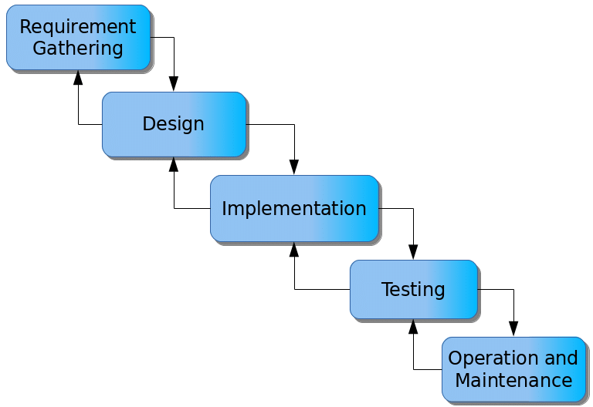
PROPOSED METHOD
The waterfall model is a linear and sequential approach to software development. It consists of distinct phases, each building upon the previous one, and progress flows in a downward direction like a waterfall. Figure 3.1 shows the waterfall model for the design and implementation of an Academic Records Management System.

Slide 8
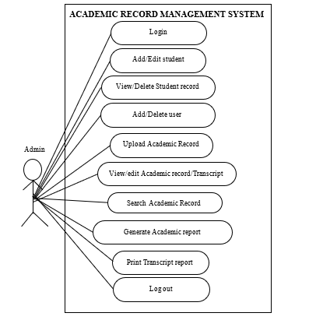
UML ALGORITHM
Use case diagram

Slide 9
SYSTEM ARCHITECTURE
Administrator
Apache Server
Database MySQL

Slide 10
REFERENCES
Ahmad, A., Ibrahim, A., Li, L. & Liu, R. (2021). Data Migration Strategy for Electronic Document Management System Implementation in Government Sector. Journal of Theoretical and Applied Information Technology, 99(12), 2822-2836.
Azimi, H., Al-Mustapha, J. & Jimiri, E. (2019). A Comprehensive Model for Academic Record Management System (ARMS) Based on Cloud Computing in Higher Education. Journal of Information Technology Management, 11(3), 471-494.
Chauhan, S., & Gupta, S. (2020). A Study on Implementation of Academic Record Management System in University: A Case Study. International Journal of Scientific & Technology Research, 9(4), 1056-1060.
Chung, K. M., & Eavis, T. (2005). Database Security and Compliance: Psychological and Organizational Factors. Communications of the ACM, 48(2), 75-79
Codd, E. F. (1970). A relational model of data for large shared data banks. Communications of the ACM, 13(6), 377-387.

Slide 11
THANKS FOR LISTENING

